Slide 1

What Mr. Spock would possibly say about modern unit testing: pragmatic and emotional overview

Slide 2
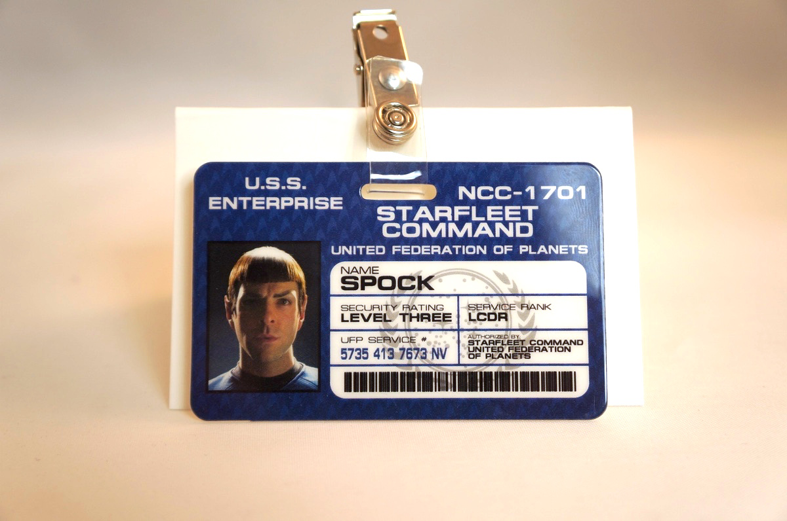
About me
Yaroslav Yermilov
Senior Software Engineer
EPAM Systems
https://twitter.com/yermilov17
https://www.facebook.com/yaroslav.yermilov
https://ua.linkedin.com/pub/yaroslav-yermilov/58/682/506

Slide 3
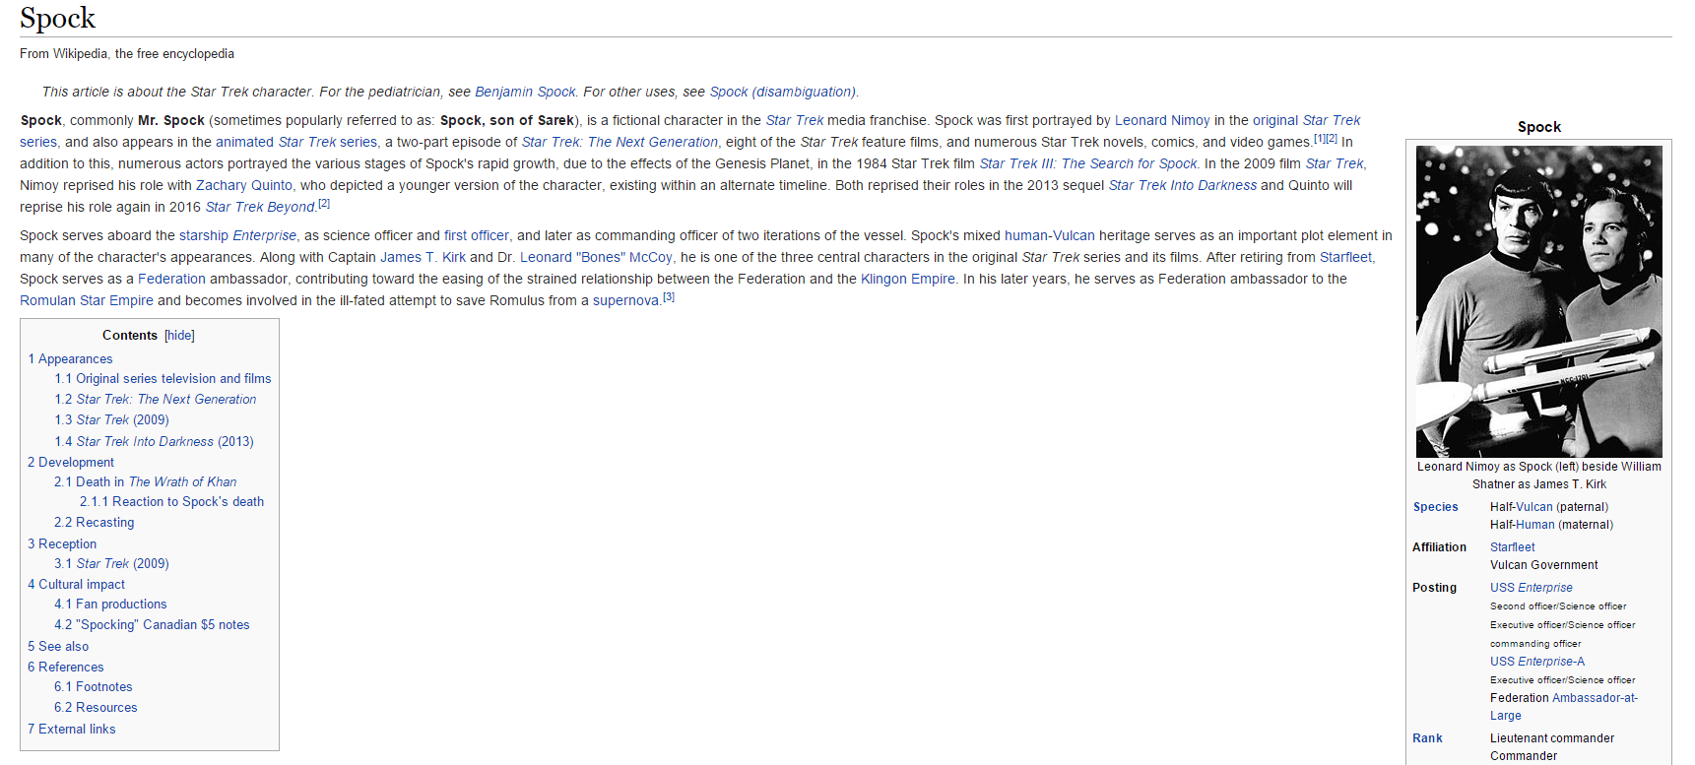
About Spock

Slide 4




Disclaimer

Slide 5

What’s the problem?

Slide 6

Better to test before going to production

Slide 7
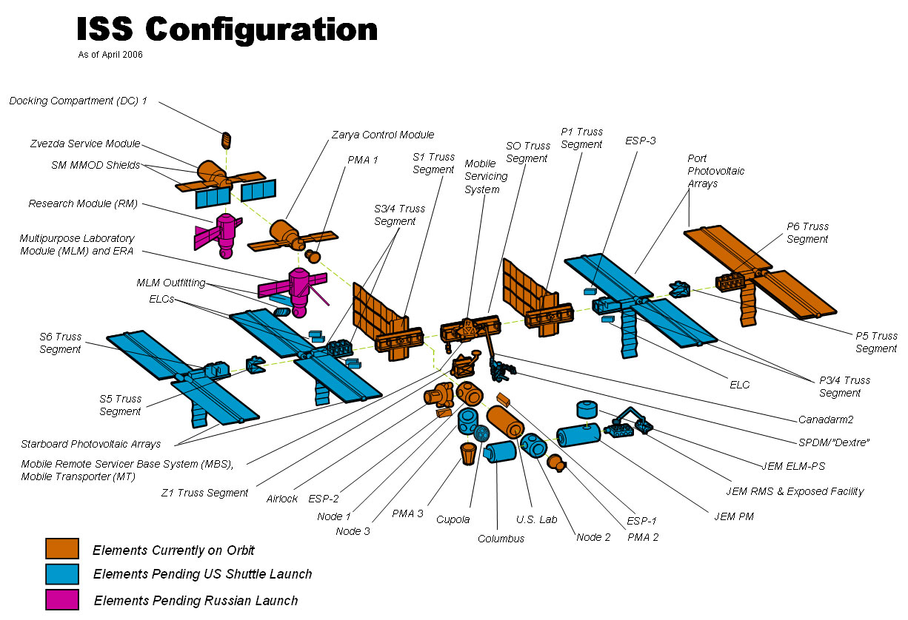
Firstly, to unit-test

Slide 8

So what?

Slide 9

JUnit?

Slide 10

TestNG?

Slide 11

Unit testing framework on steroids?
Hamcrest
AssertJ
Google Truth
Mockito
PowerMock
JMockit

Slide 12

Spock?

Slide 13

Something odd?
Cucumber
J8Spec JGiven

Slide 14

Nothing?

Slide 15

Automated testing
is a great concept

Slide 16

But have you ever felt like it’s frozen for the last years?

Slide 17
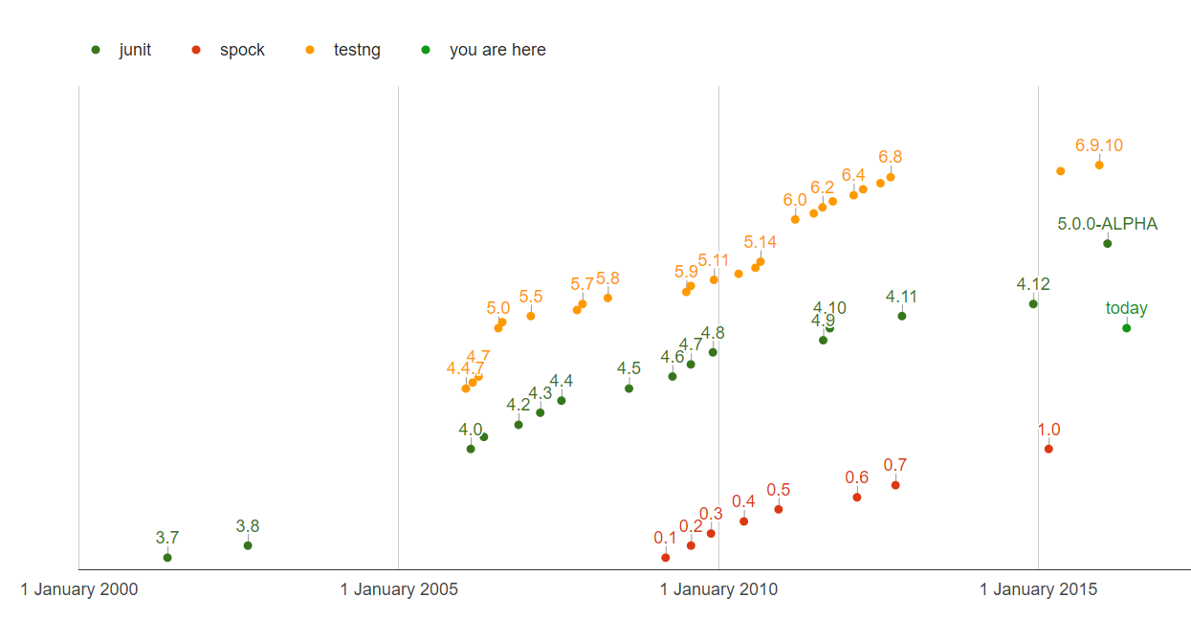
QUIZ: How many test framework releases we had since 2013?

Slide 18

So why don’t try Spock?

Slide 19

Spock is the next generation testing framework

Slide 20
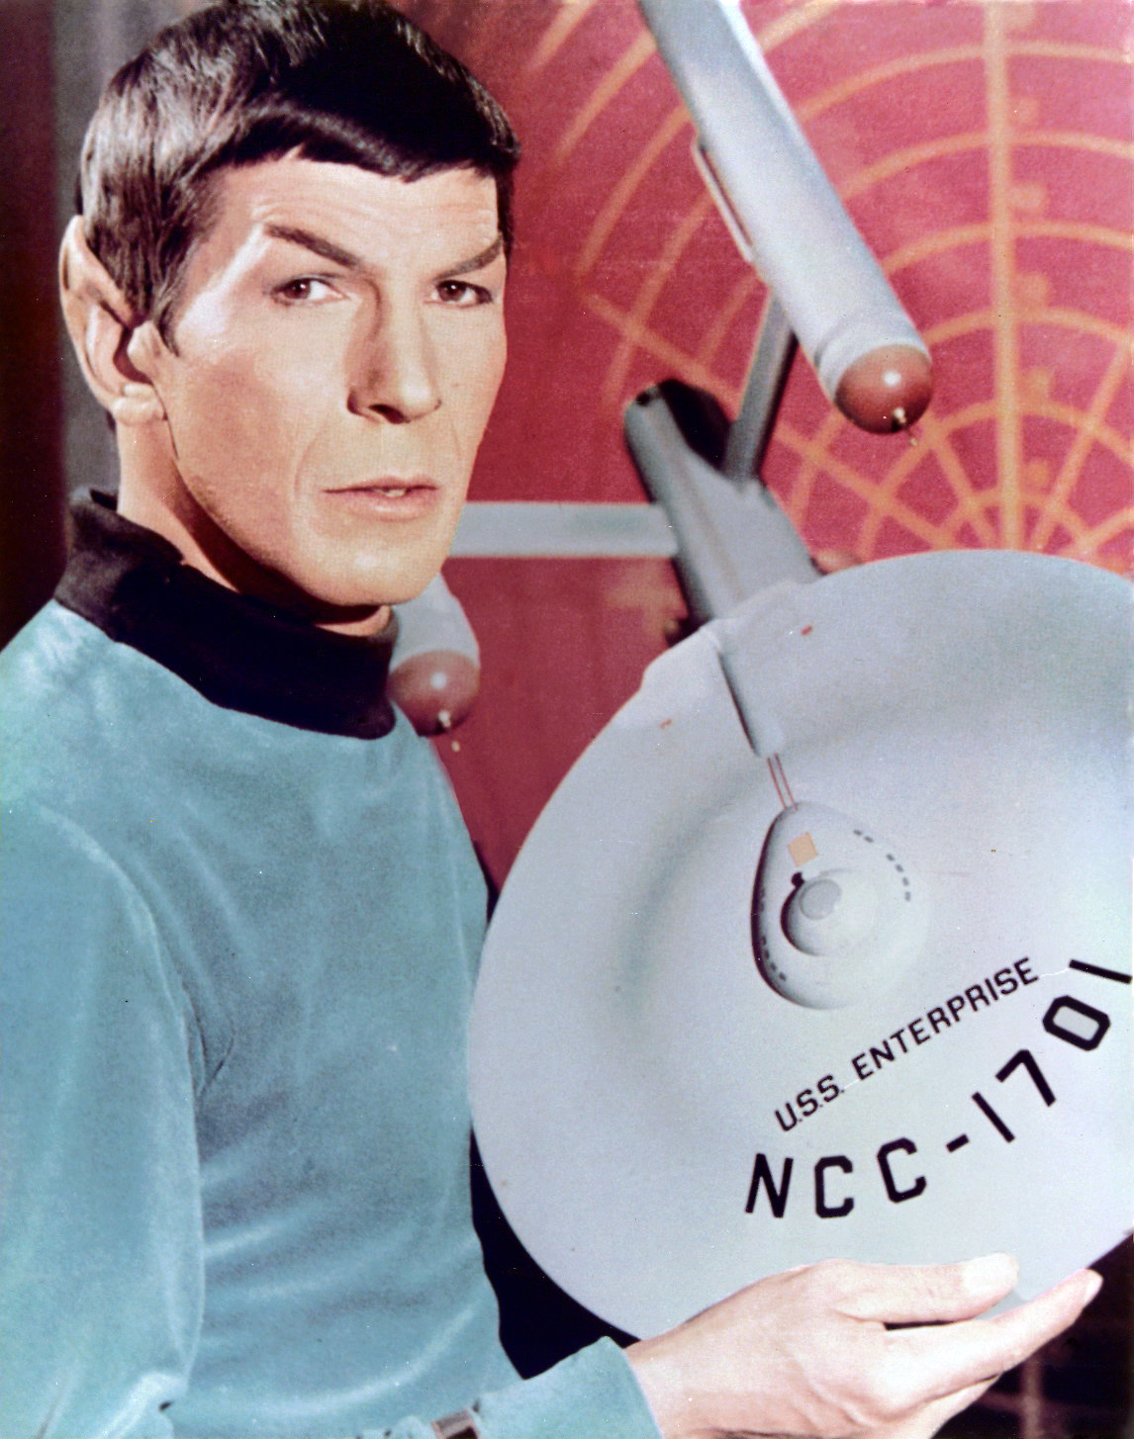
Spock is Enterprise ready

Slide 21
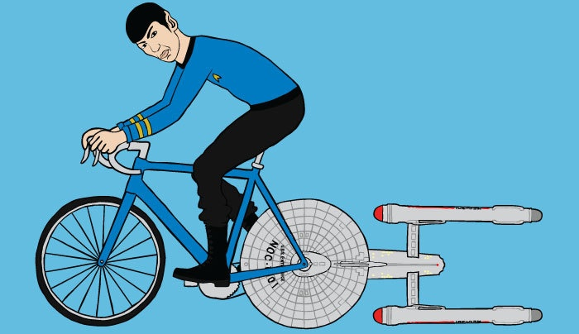
Let’s go!
https://github.com/yermilov/spock-talk

Slide 22

Episode I: Every journey starts somewhere

Slide 23
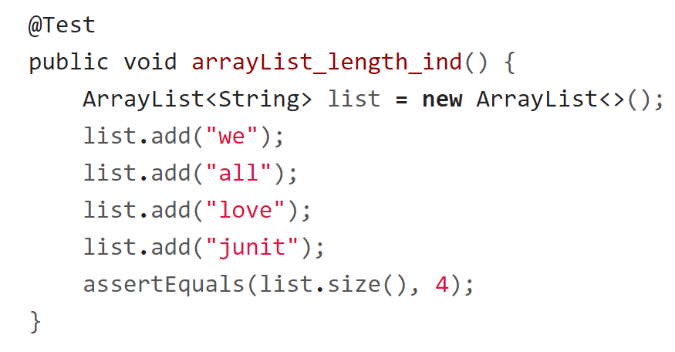
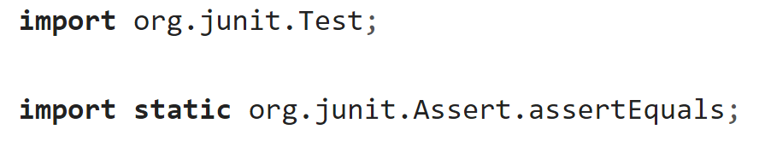
Episode I: Every journey starts somewhere

Slide 24
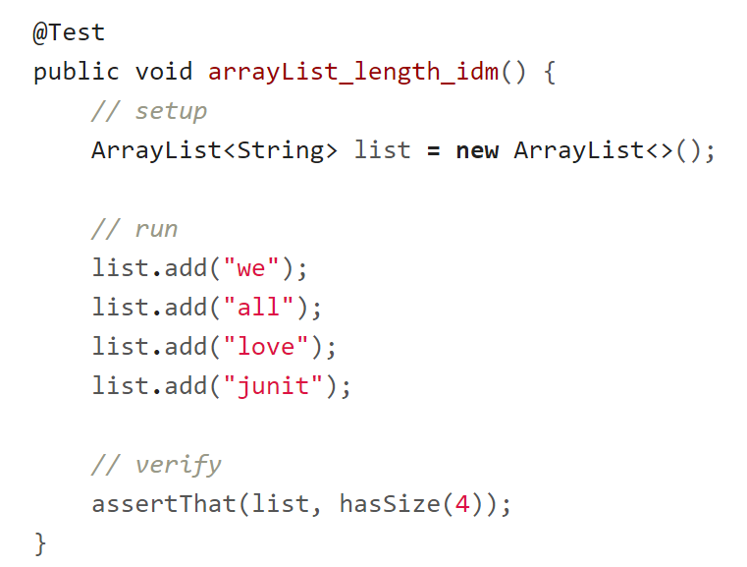
Episode I: Every journey starts somewhere

Slide 25
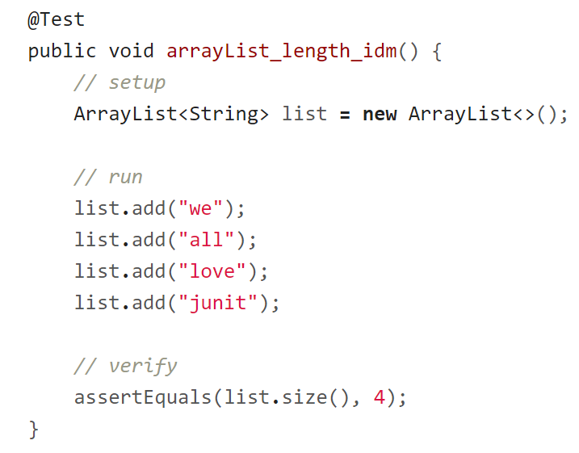
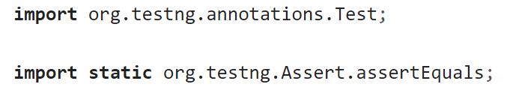
Episode I: Every journey starts somewhere

Slide 26

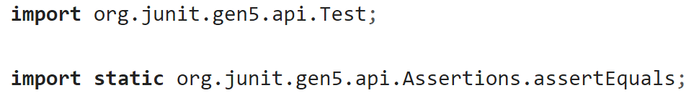
Episode I: Every journey starts somewhere

Slide 27
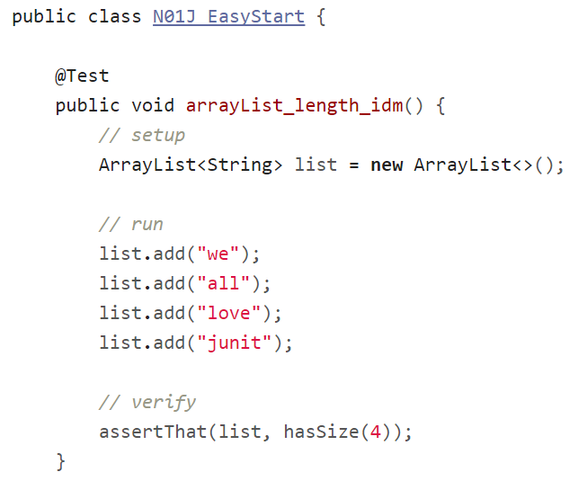
Episode I: Every journey starts somewhere

Slide 28
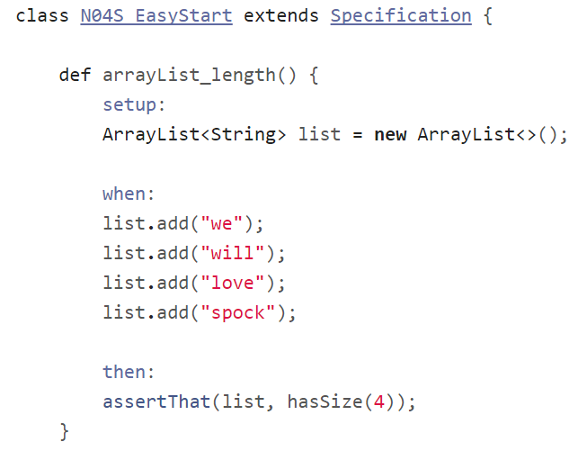
Episode I: Every journey starts somewhere

Slide 29
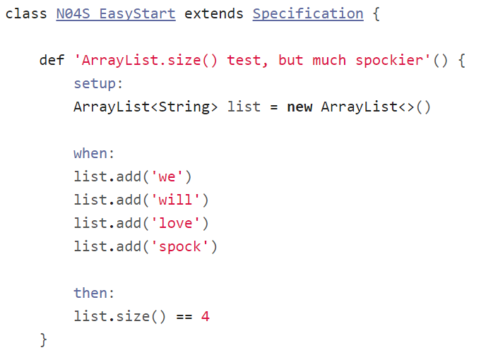
Episode I: Every journey starts somewhere

Slide 30

Episode II:
Assertions

Slide 31
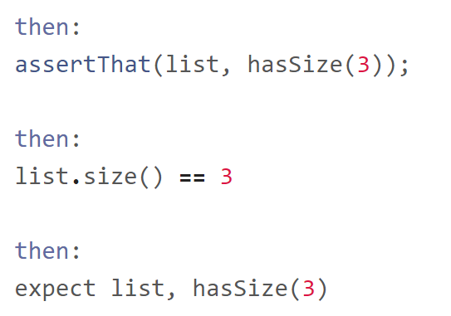
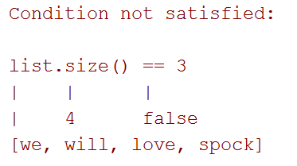
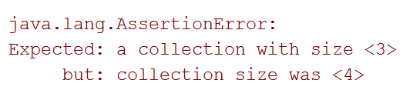
Episode II: Assertions

Slide 32
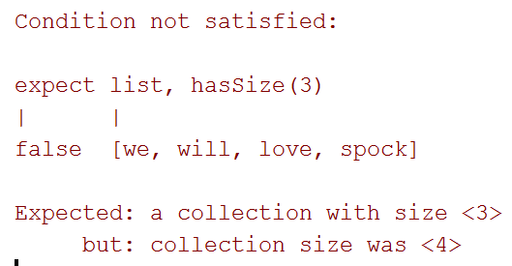
Episode II: Assertions

Slide 33
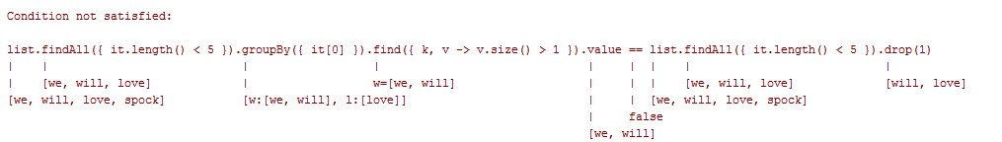
Episode II: Assertions

Slide 34
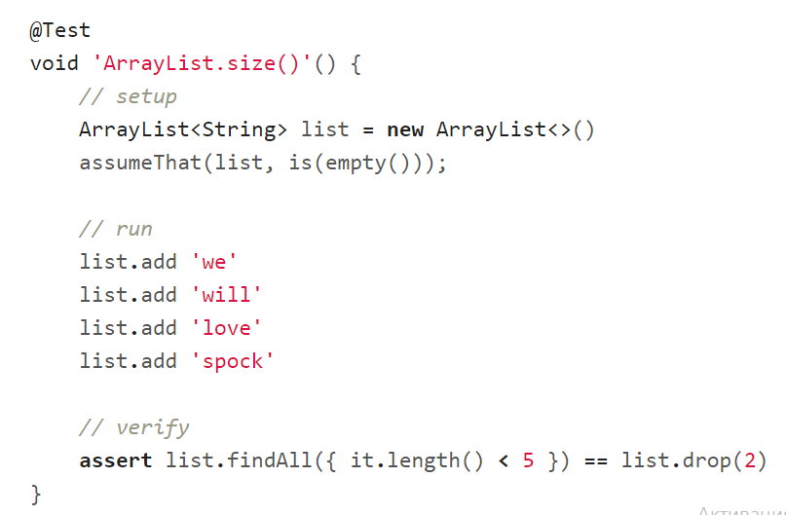
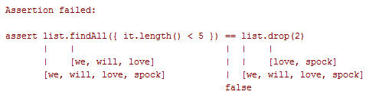
Episode II: Assertions

Slide 35
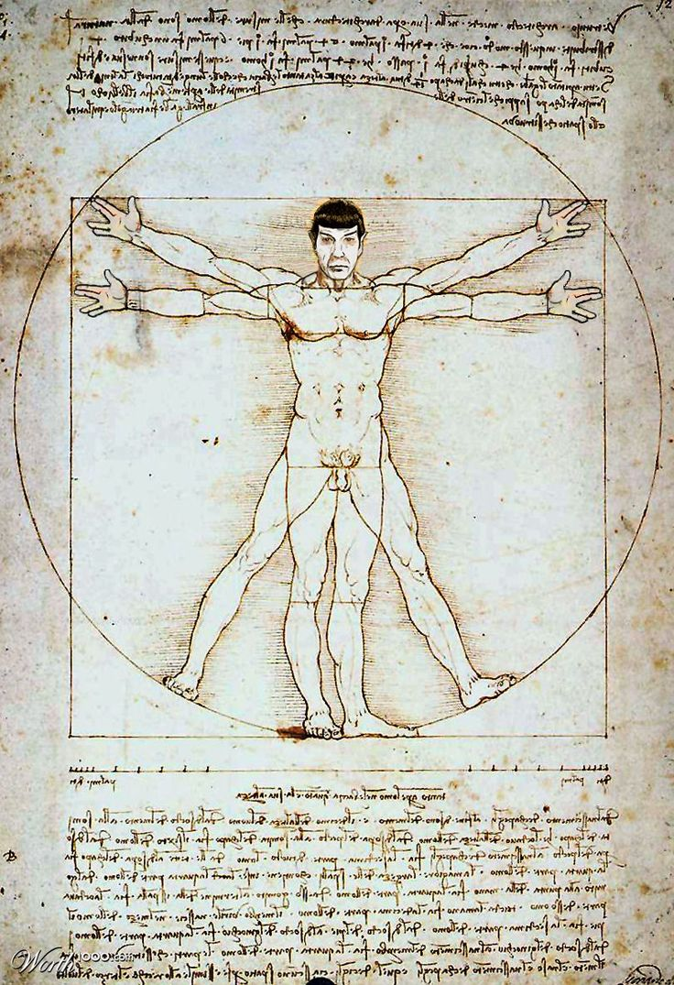
Episode III: Idiomatic Spock

Slide 36
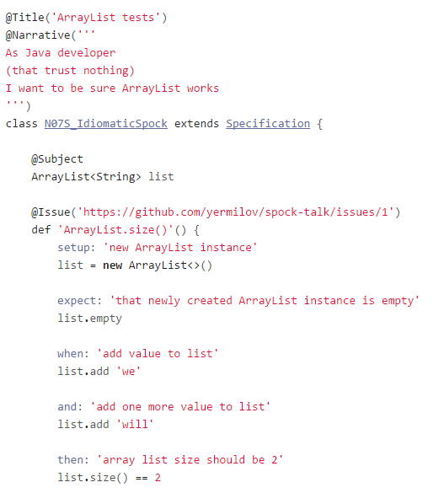
Episode III:
Idiomatic Spock

Slide 37
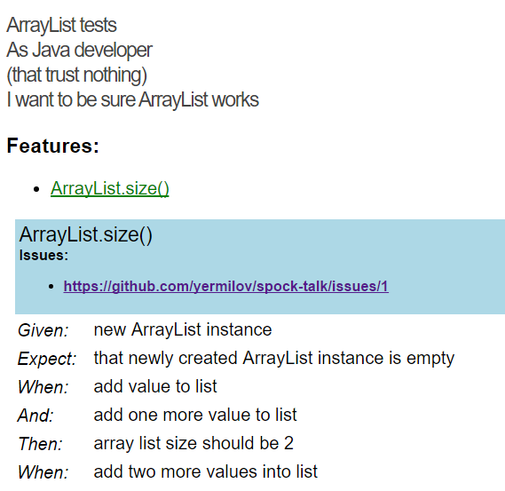
Episode III:
Idiomatic Spock

Slide 38
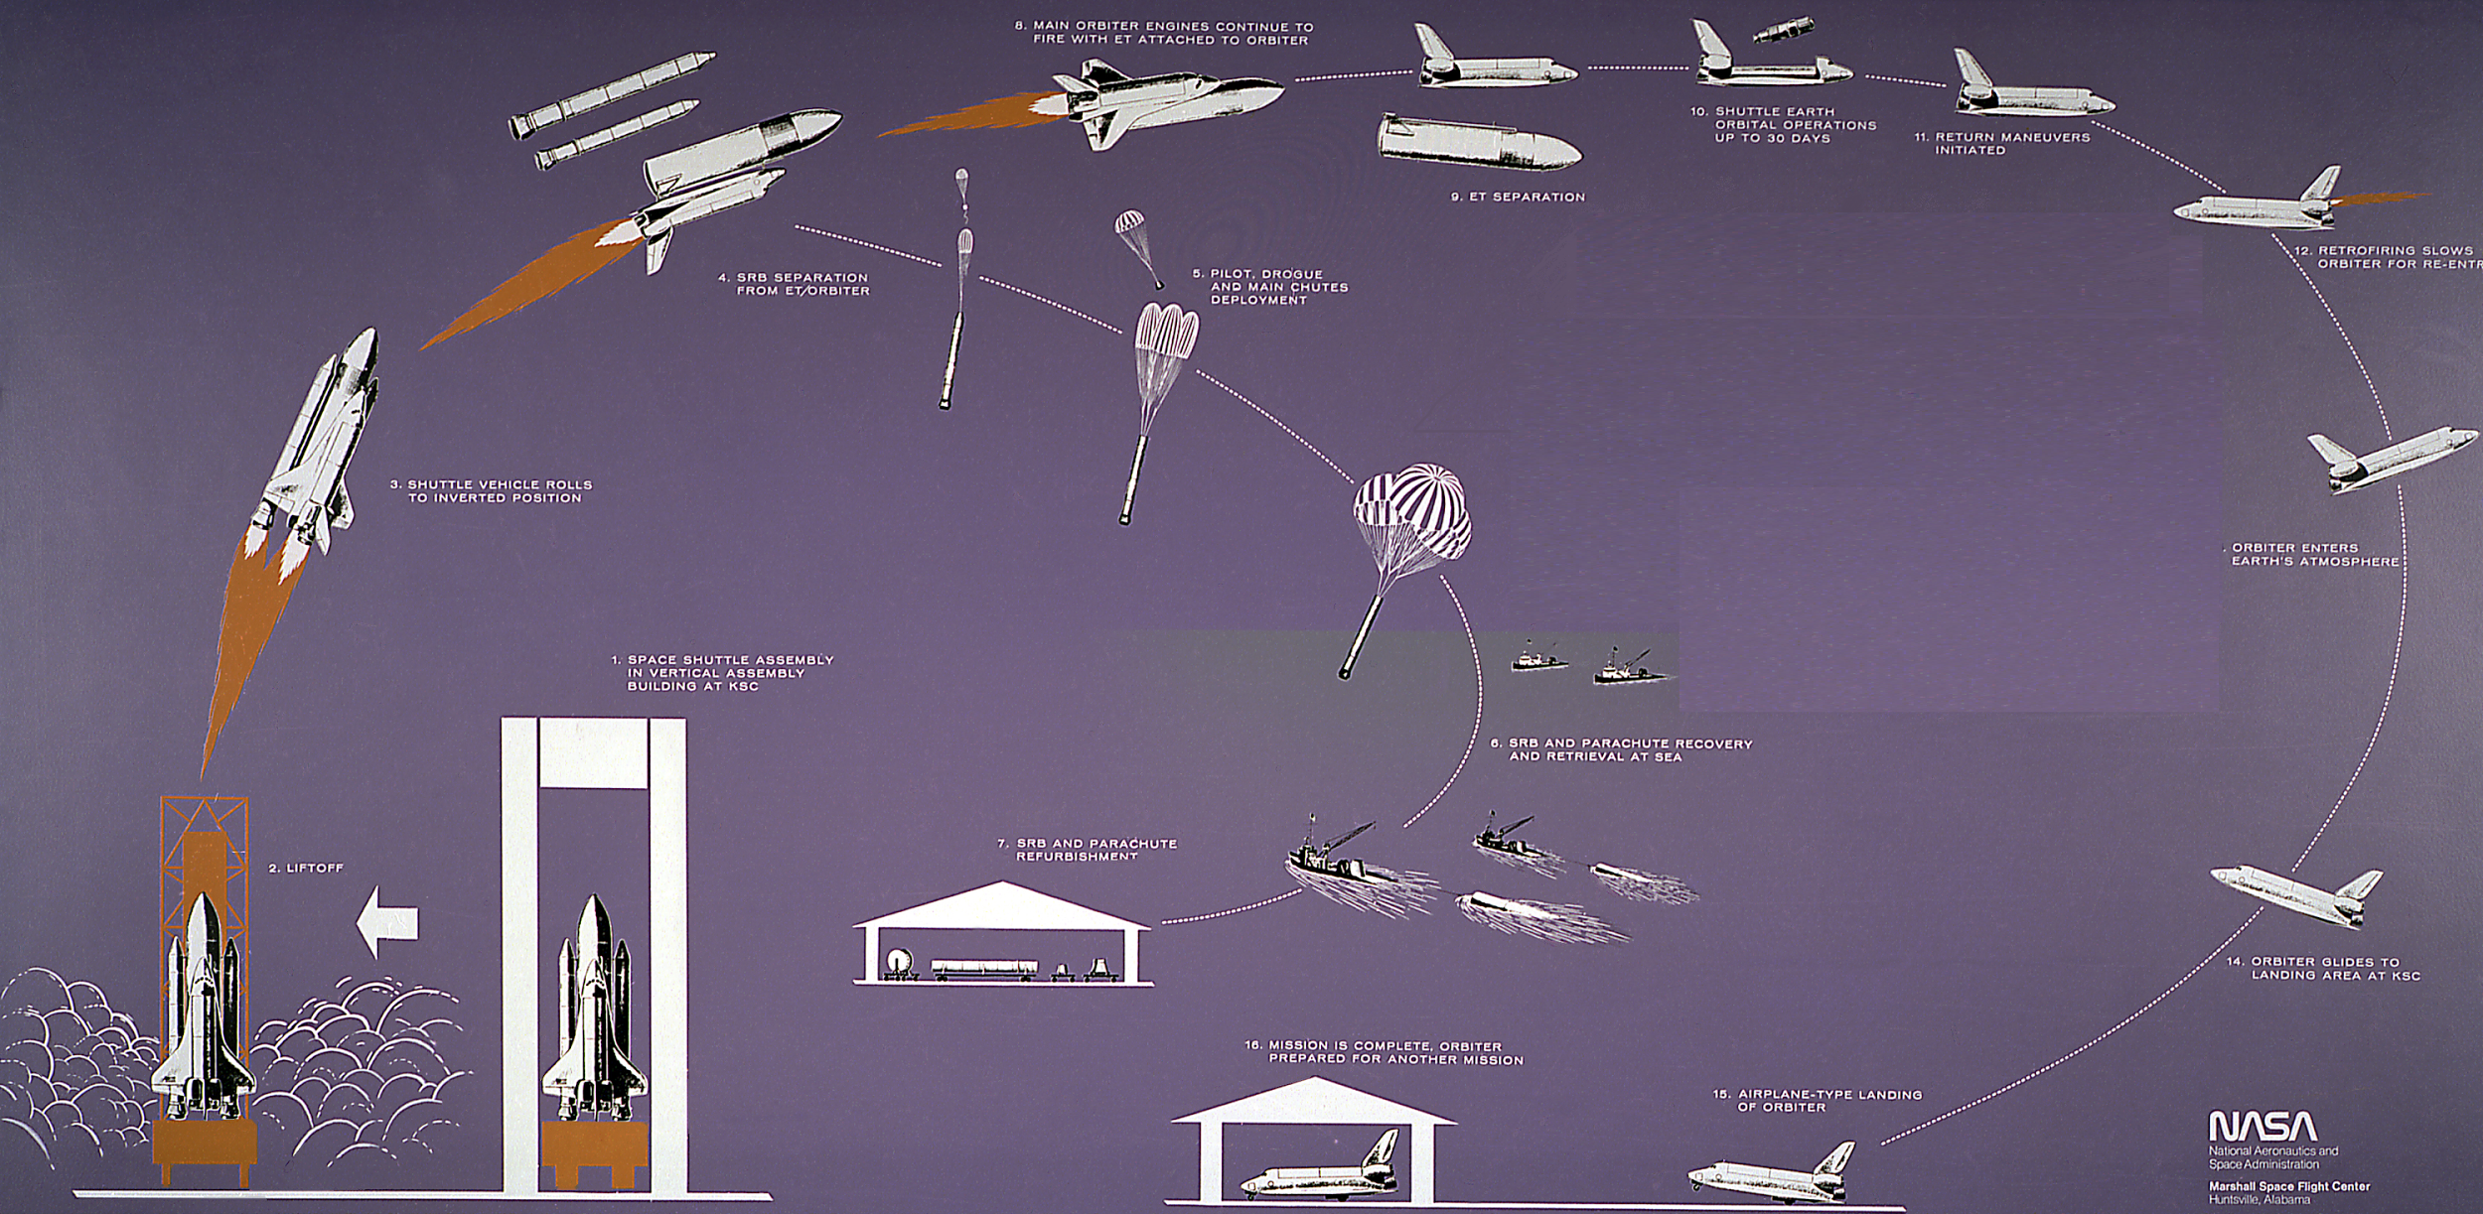
Episode IV:
Setup/Teardown

Slide 39
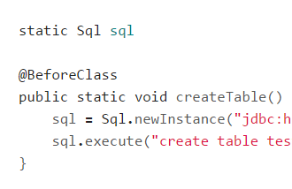
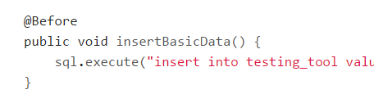
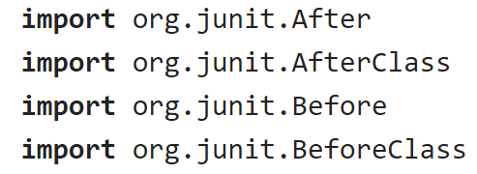
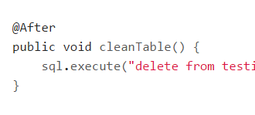
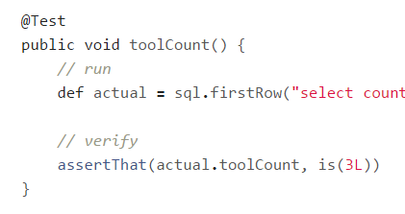
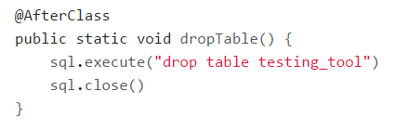
Episode IV: Setup/Teardown

Slide 40
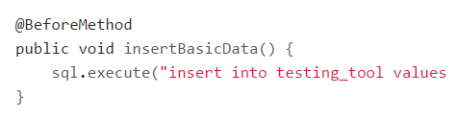
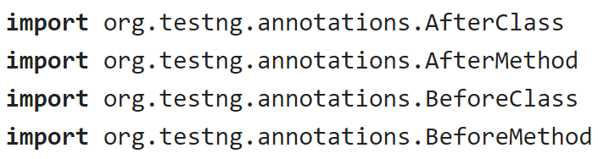
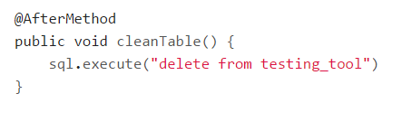
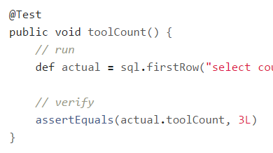
Episode IV: Setup/Teardown

Slide 41
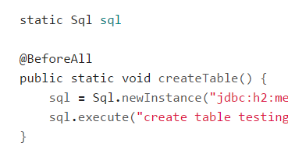
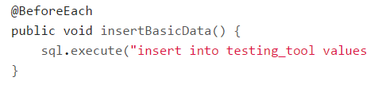
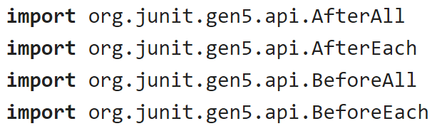
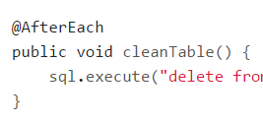
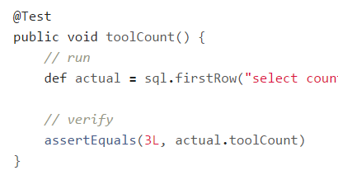
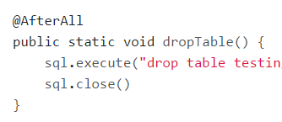
Episode IV: Setup/Teardown

Slide 42
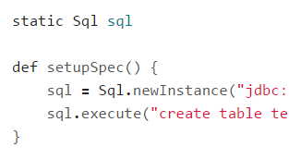
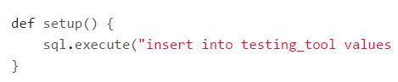
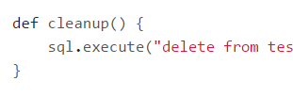
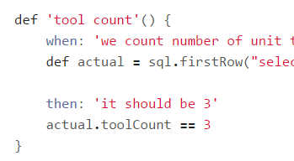
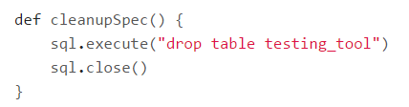
Episode IV: Setup/Teardown

Slide 43
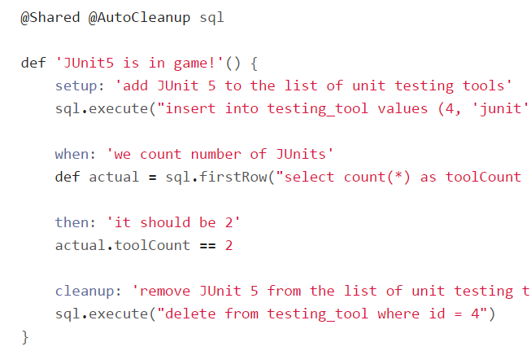
Episode IV: Setup/Teardown

Slide 44
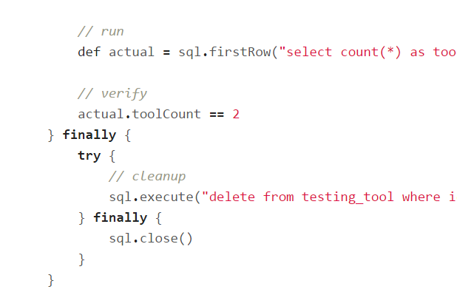

Episode IV: Setup/Teardown

Slide 45





Episode IV: @Shared or static?

Slide 46

Episode V:
Data driven test

Slide 47
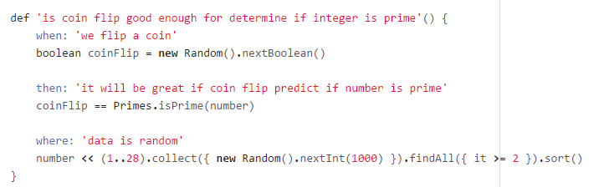
Episode V: Data driven test

Slide 48

Episode V: Data driven test

Slide 49

Episode V: Data driven test

Slide 50

Episode V: Data driven test

Slide 51

Episode V: Data driven test

Slide 52

Episode V: Data driven test

Slide 53

Episode V: Data driven test

Slide 54

Episode V: Data driven test

Slide 55

Episode VI:
Exceptions

Slide 56

Episode VI: Exceptions

Slide 57

Episode VI: Exceptions

Slide 58

Episode VI: Exceptions

Slide 59

Episode VI: Exceptions

Slide 60

Episode VI: Exceptions

Slide 61

Episode VI: Exceptions

Slide 62

Episode VI: Exceptions

Slide 63

Episode VI: Exceptions

Slide 64

Episode VI: Exceptions

Slide 65

Episode VII:
Mocks,
Stubs,
Spies

Slide 66



Episode VII: Mocks, Stubs, Spies

Slide 67



Episode VII: Mocks, Stubs, Spies

Slide 68



Episode VII: Mocks, Stubs, Spies

Slide 69


Episode VII: Mocks, Stubs, Spies

Slide 70

Episode VII: Mocks, Stubs, Spies

Slide 71

Episode VIII: Time travel

Slide 72

Episode VIII: Time travel

Slide 73

Episode VIII: Time travel

Slide 74

Episode VIII: Time travel

Slide 75

Episode VIII: Time travel

Slide 76

Episode VIII: Time travel

Slide 77

Episode VIII: Time travel

Slide 78

Episode VIII: Time travel

Slide 79

Episode VIII: Time travel

Slide 80

Episode IX:
Test control

Slide 81

Episode IX: Test control

Slide 82

Episode IX: Test control

Slide 83

Episode IX: Test control

Slide 84

Episode IX: Test control

Slide 85

Episode IX: Test control

Slide 86

Episode IX: Test control

Slide 87

Episode IX: Test control

Slide 88

Episode IX: Test control

Slide 89

Episode IX: Test control

Slide 90

Episode X: Encore

Slide 91

Episode X: Encore

Slide 92

Why one should use Spock?

Slide 93

Concise syntax

Slide 94

Language for testing instead of testing struggling language

Slide 95

Clear test structure

Slide 96

Code and reports readable for everyone

Slide 97

Powerful built-in features

Slide 98

Extensions

Slide 99

Useful for unit, integration and functional tests

Slide 100

Behaves as one more JUnit runner

Slide 101

Works for both Groovy and Java

Slide 102

Why one should not use Spock?

Slide 103

JUnit/TestNG has 90% similar/imitable features

Slide 104



Spock lost its lead developer

Slide 105

When one can use Spock?

Slide 106

Your team is ready to make one step forward

Slide 107

You are about to start new project

Slide 108

You want to cover legacy project with unit tests

Slide 109

You want to introduce functional testing in your project

Slide 110

What’s next?
http://spockframework.github.io/spock/docs/1.0/index.html
http://meetspock.appspot.com/
https://github.com/spockframework
Just use it in your projects and enjoy!

Slide 111

Thanks!

